Slide 1

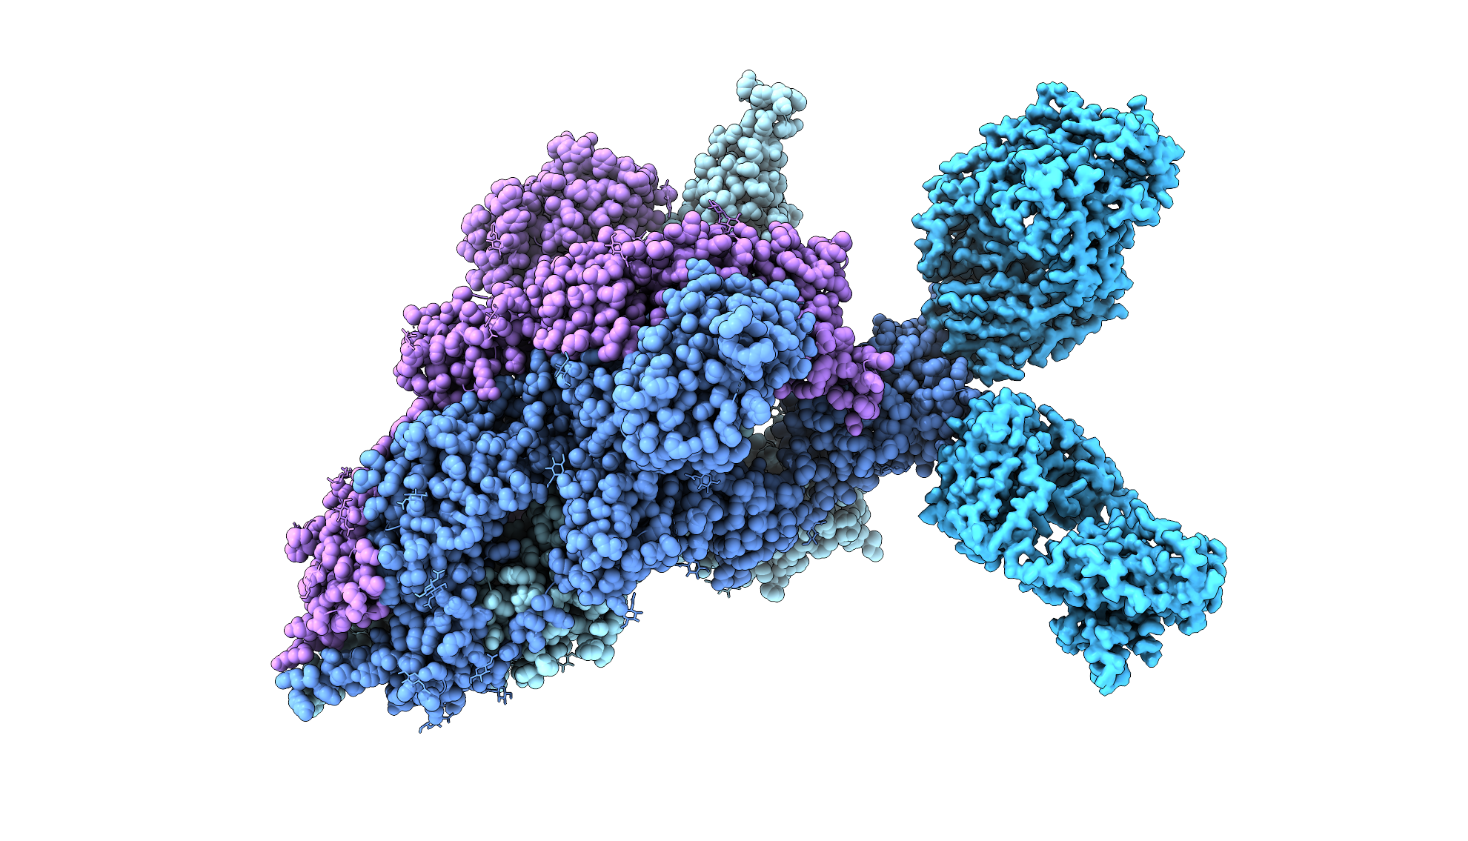
Overcoming the Challenges of Scaling MX Data Analysis
2025 November 18th
Oleg Mikhailovskii, PhD
Computational Structural Biologist
oleg@cryocloud.io
Notes:
“With that, I’ll hand over to Robert, who’ll give us a short introduction to the new X-ray crystallography pipeline — how it fits into the CryoCloud platform and what we’ve been working on behind the scenes.”

Slide 2



About CryoCloud
Offering an
integrated end-to-end solution for data storage and analysis:
Our goal:
Automate cryo-EM data analysis
Developing cloud-native cryo-EM software since
2021
© CryoCloud, 2025
confidential, do not share

Slide 3





CryoCloud – first in many areas
NEW
e⁻
γ
+
Only cryo-EM platform integrating infrastructure + algorithms
First & only ISO certified cryo-EM cloud platform
First native Integration of cryo-EM + X-ray workflows

Slide 4

CryoCloud’s 3 core technologies
Scalable cloud Infrastructure
Intuitive app & integrated workflows
Optimized image analysis algorithms
© CryoCloud, 2025
confidential, do not share
More info visit: www.cryocloud.io

Slide 5
CrystalCloud

Slide 6

How does our solution fit in the MX workflow?
Raw data from the synchrotron
Indexing, scaling & merging
Molecular Replacement & Refinement
Ligand fitting, restraint generation
Another round of refinement + visualisation
AutoPROC | “Limited” MR with Phaser Structure refinement with BUSTER Ligand density elicitation | Ligand fitting with Rhofit | Validation with MolProbity
 | Reference Matching | Restraint generation with AceDRG or Grade2 | Result inspection via an intuitive user interface
Global Phasing Pipedream
+ Run >100 jobs in parallel
CryoCloud integration
+ One platform for MX & Cryo-EM
CryoCloud provides fully automated analysis from raw data to ligand fitting & validation

Slide 7
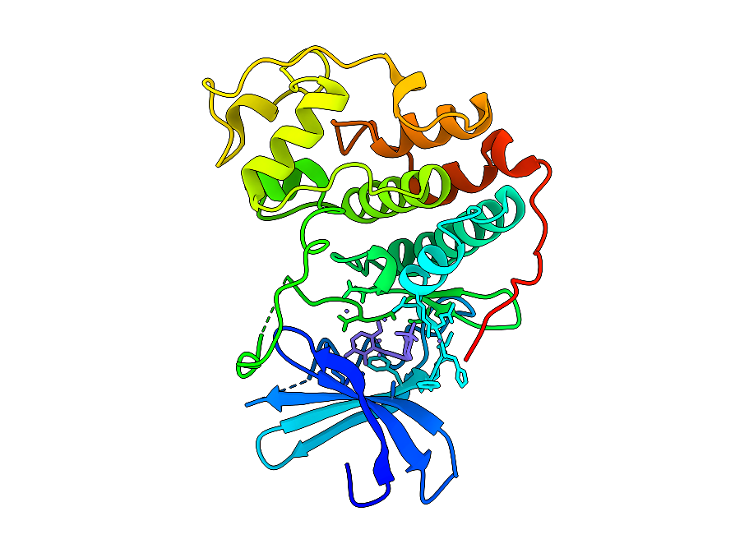
2FVD.pdb
Visualizing the results
Notes:
Chimera X session: https://cryocloud.sharepoint.com/:u:/s/CommercialTeam/EQ7VMxB0aNVMmJ5Un6ePDzMBF-z3MgtnrPwRzJaCz3qvuQ?e=x6B0nY

Slide 8
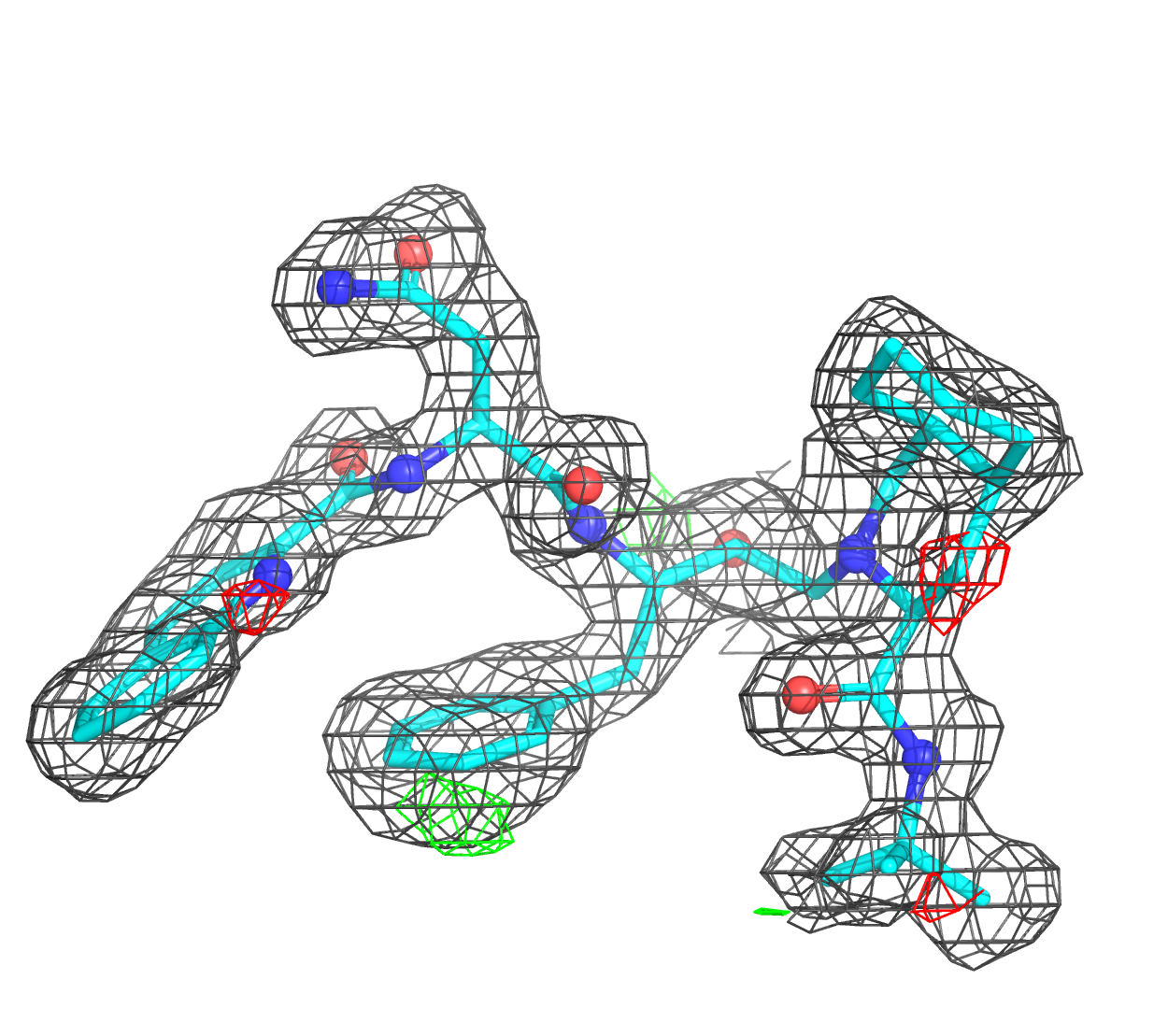
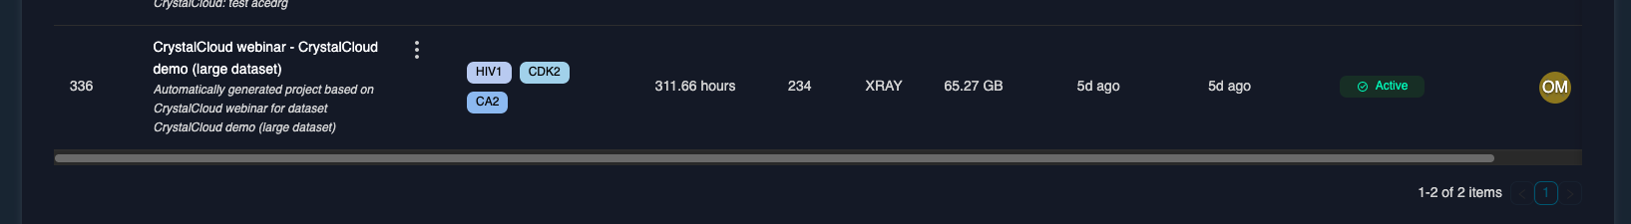
High-throughput analysis of 234 datasets in 10h
234 datasets of 3 targets were analyzed with the same workflow:
HIV1
CA2
CDK2
Processing time: 10 h
Total compute time: 311 h | 1.3 h per dataset
Throughput: >500 datasets per day

Slide 9
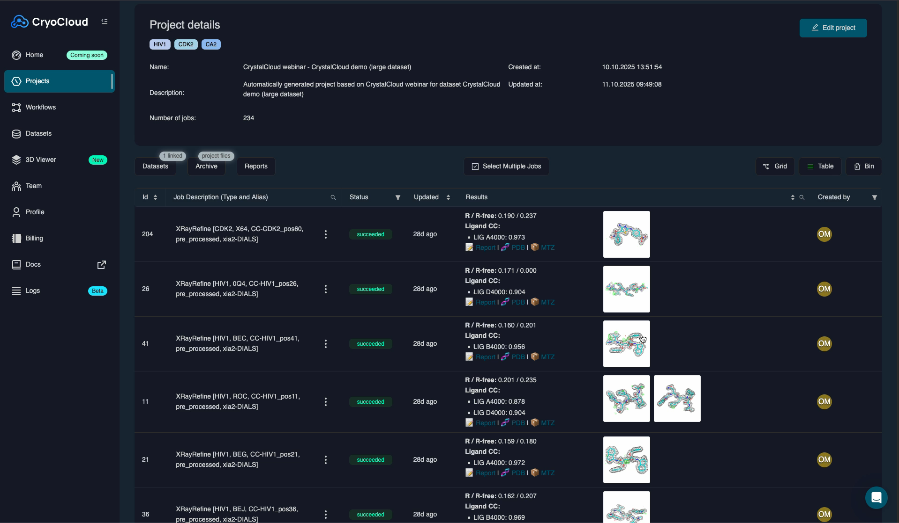

Slide 10
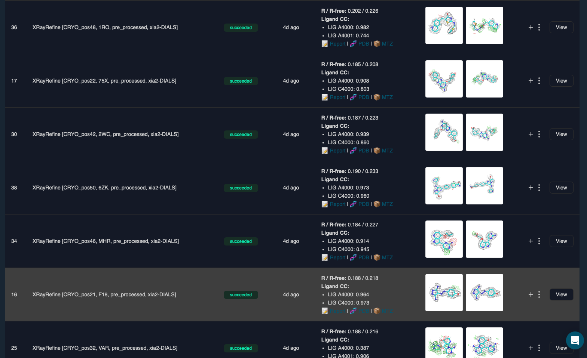
Results page displays whether data analysis succeeded

Slide 11
Pipedream workflow

Slide 12
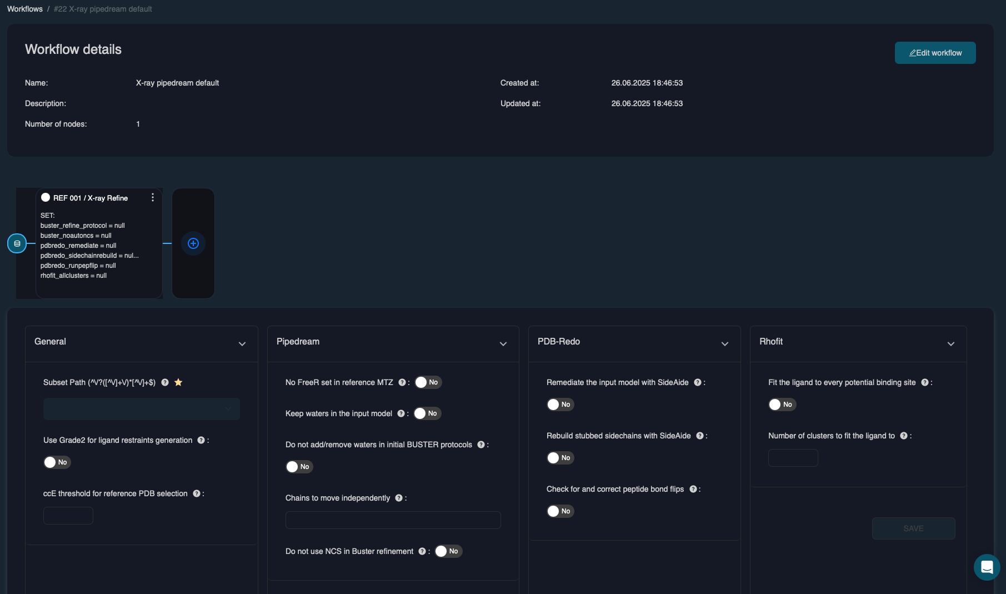
Workflow editor allows you to configure your Pipedream runs

Slide 13
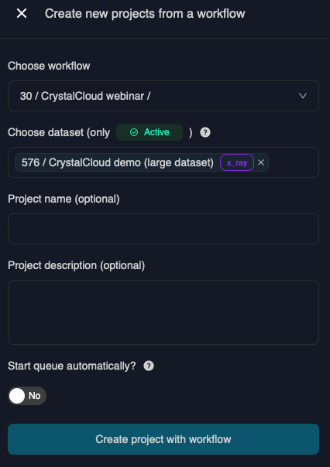
Starting a project from a workflow
Workflows enable automated & parallel analysis of all datasets from a session:
Workflows allow you to submit data analysis of 100’s of datasets from multiple sessions with just 7 clicks
Notes:
Click here to access a 2 min XRC data import demo

Slide 14
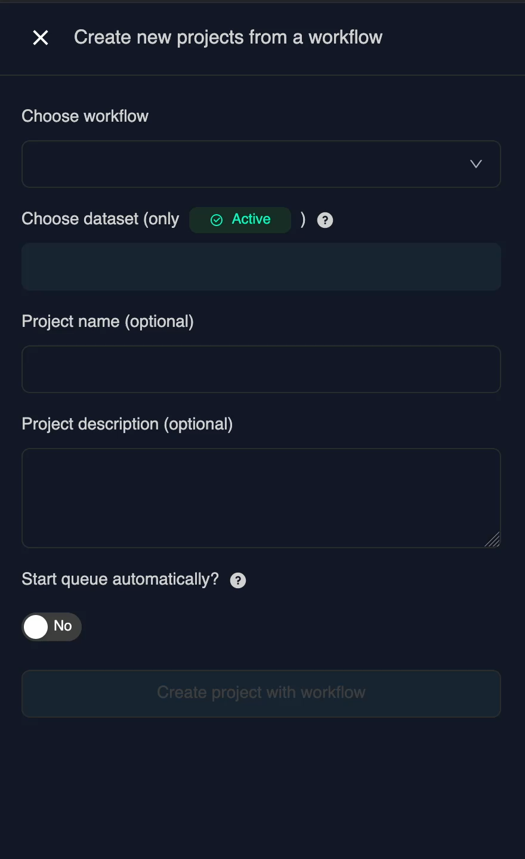
Starting a project from a workflow
Workflows enable automated & parallel analysis of all datasets from a session:
Workflows allow you to submit data analysis of 100’s of datasets from multiple sessions with just 7 clicks
Notes:
Click here to access a 2 min XRC data import demo

Slide 15
Dataset import

Slide 16
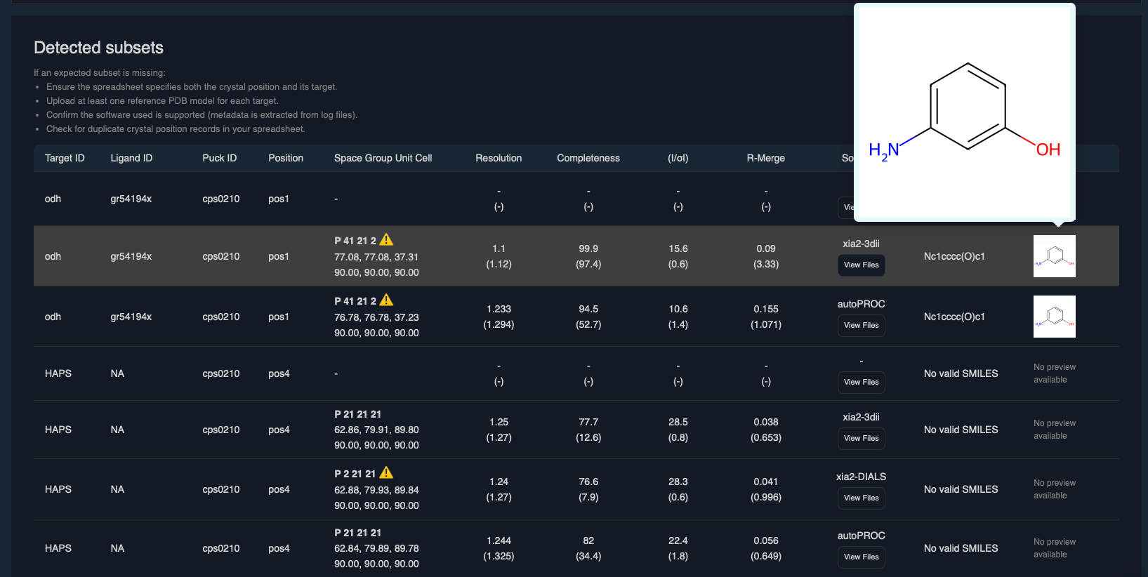
Dataset Import: The Solution
Notes:
Click here to access a 3 min XRC data import demo

Slide 17
The Problem
Data from ESRF and Diamond
Spreadsheet (ISPYB standard format) with records of scans
S3 bucket/storage with 1,000s-1,000,000s of files
A Solution
Parsing of CSV Metadata
Identification of Data Subfolders
Matching the data

Slide 18
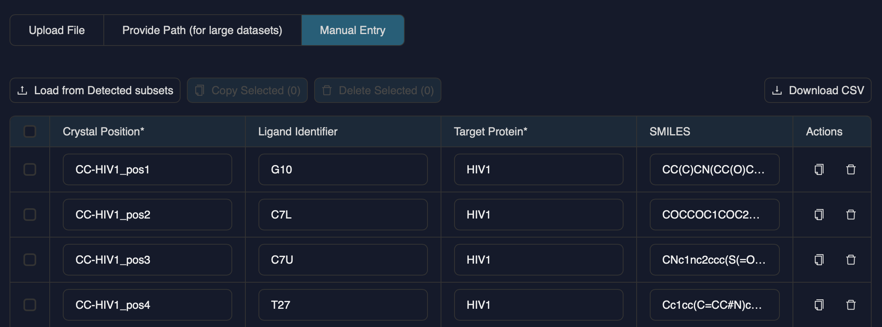
The Solution: Parsing the spreadsheet
Validate required columns (Sample Name, Target ID) and optional columns, sanitize
Using Crystal Position as the key
Keeping all the other columns for traceability

Slide 19
Problems
Headers although very close still DO vary
ESRF: Image prefix, Beamline, Run no, Start Time, Sample Name, Protein Acronym, # images, Wavelength (angstrom), Distance (mm), Exp. Time (sec), Phi start (deg), Phi range (deg), Xbeam (mm), Ybeam (mm), Detector resol. (angstrom), Crystal class, Comments, REGNO, SMILES
Diamond: Image prefix, Beamline, Run no, Start Time, Sample Name, Protein Acronym, # images, Wavelength (angstrom), Distance (mm), Exp. Time (sec), Phi start (deg), Phi range (deg), Xbeam (mm), Ybeam (mm), Detector resol. (angstrom), Comments, REGNO, SMILES
Need to use aliases and sanitizations: extra spaces, extra dots, varying registers
Populated differently between facilities
Image prefix cannot be used as a Key for the record
Protein Target / Acronym variability: Diamond format `<name>.1`
Sample Name is the same as Image prefix at Diamond
Production scan identification
# images is NOT always the highest
Exposure time is NOT always uniquely the lowest
Run number is NOT always uniquely the highest
Start Time is NOT always the latest

Slide 20
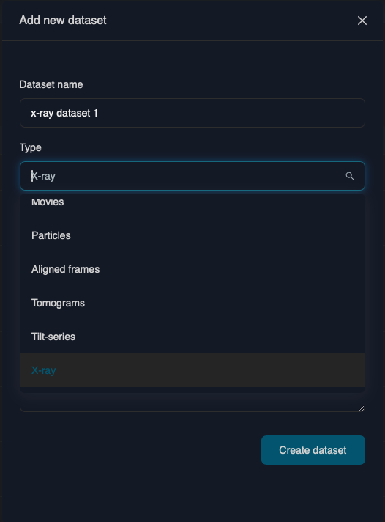
Files scanning
Upon the full bucket scan*:
Subset of PDB files is being stored separately
Within each directory we try to identify both raw & pre-processed MX datasets based on common filename suffix patterns*
For each of the supported pre-processed datasets, we try to extract metadata (unit cell, completeness, R_merge, etc.):
xia2-3d
xia2-3dii
xia2-dials
xia2-dials-aimless
Grenades
autoPROC
other software coming soon
*Bucket can be huge
*We don't want to pick up ALL mtz's

Slide 21
More Problems
The same software processing the data file names vary between facilities and/or could be close for different software:
*truncate-unique.mtz and *truncated-unique.mtz for autoPROC and Grenades cases. And that's only a suffix, and even unique is not always there
Or, xia2 pre-processed suffixes
For metadata parsing, the autoPROC-produced xml-file is sometimes there, sometimes is not
Fortunately, xia2-summary.dat logs are always there, or are they?

Slide 22
Matching the data
At this point:
1(?) CSV record per Crystal Position / Sample Name with a Target ID
Set of MTZ files with metadata
Set of reference PDB files
Using Crystal Position / Sample Name (<puckID>_<posID>) as the key
MUST be in the MTZ's path either as a prefix or suffix (`_` or `-` as a separator)
PDB filename must be prefixed with the Target ID
Problems:
Image prefixes are not always actually used
Simple `in` condition triggers falsely (`cps0210_pos1` in `<pID>-cps0210_pos10_1`)

Slide 23
Questions and Remarks
The current solution works. But for how long ? ….and this is only for using two synchrotrons
Unified framework is needed: critical for long-term and multi-facility work
Mark production scans in a dedicated column
How the spreadsheet are being formulated and why they have that specific format?
Header AND fields (incl. Image prefix, Protein Acronym, Comments)
Difference between Sample Name and Image Prefix, if it's there
The hierarchical nature of folder structure is not an issue. The issue is naming conventions

Slide 24
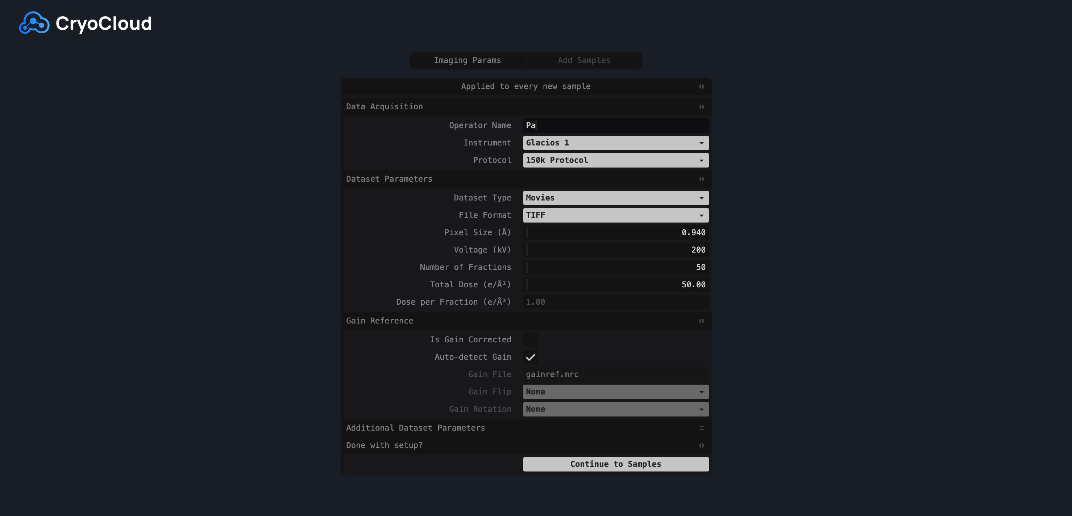
Suggestion
Configuration tool to/from the facilities on the spreadsheet formation, folder structure and/or naming conventions
<insert a screenshot of our cryo-EM configuration tools>

Slide 25







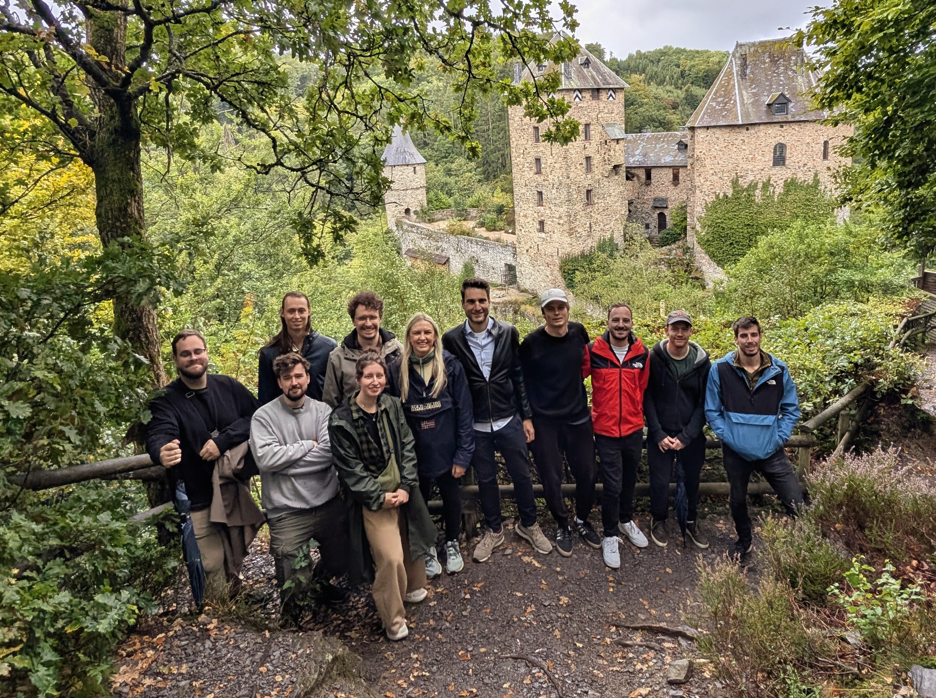
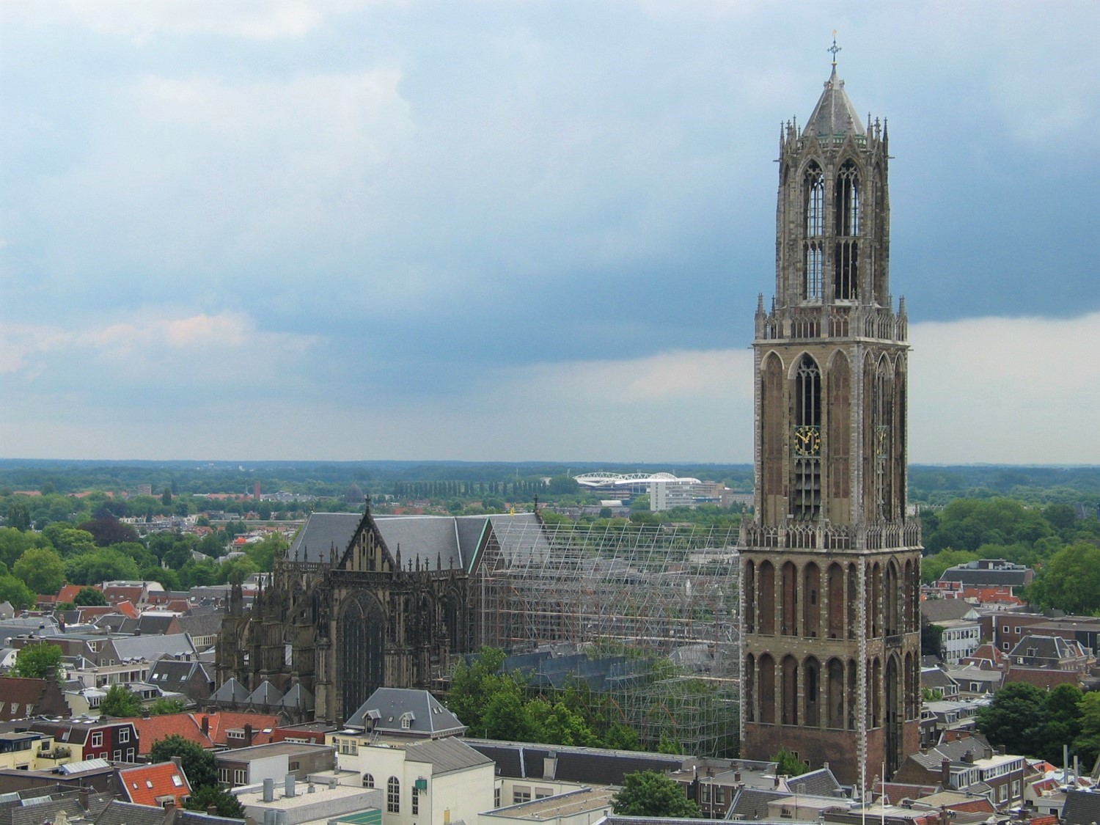

Thank You!
Thanks to:
Willing to collaborate?
Curious to test the pipeline?
Contact us!
Team
Utrecht, the Netherlands

Slide 26
Back up

Slide 27
Licenses needed to run CryoCloud X-ray Crystallography Processing Pipeline
Active CryoCloud Subscription
Global Phasing
CCP4
XDS (optional, for raw data input)
CSD (optional, for Grade2)

Slide 28




CryoCloud complies with the highest security standards
Certified in 01/25
CryoCloud Private Cloud
Easy procurement through your existing AWS account
CryoCloud deployed in your custom environment, e.g.: company.cryocloud.io
Integrate with your existing cloud or server infrastructure
Notes:
We are working with 5 extertnal

Slide 29
Integrating Global Phasing into the CryoCloud dashboard
Project initiated through Jim from GSK
3 Goals:
e⁻
γ
Integration
Accuracy
Track all relevant metadata from X-ray sessions incl. ligand and preprocessing results
High-throughput
Enable automated and parallelized analysis of datasets
One streamlined interface to manage Cryo-EM and X-Ray projects

